Slide 1
Course Title
Entrepreneurship Development in Bangladesh
Course Code-BUS-341
Dr. Md Zillur Rahman
Associate Professor
Dept. of Business Administration
SUST, Sylhet

Slide 2
Lecture
Topics
Business Opportunity
Qualities of an opportunity
Ways to identify an opportunity
Blue Ocean Strategy
Red Ocean Strategy

Slide 3
Business Opportunity
A business opportunity is a set of circumstances or conditions that allows an individual or company to engage in a profitable business venture. These opportunities typically arise when a gap in the market or a new trend is identified, and it presents a potential for generating income, solving a problem, or fulfilling a demand.
Key Elements of a Business Opportunity:
Profitability: The opportunity must have the potential to generate income and return on investment.
Demand: There should be a market for the product or service, whether emerging or existing.
Innovation or Uniqueness: A business opportunity often involves an innovative idea or a unique solution that differentiates it from competitors.
Feasibility: The opportunity should be realistic in terms of required resources (capital, skills, time) and market conditions.
Scalability: It should offer room for growth, either by expanding the product line, reaching new customers, or entering new markets.

Slide 4
Types of Business Opportunities:
Product-based opportunities: Selling or creating a new product that addresses unmet needs or solves a specific problem.
Service-based opportunities: Providing a service (e.g., consulting, design, marketing, maintenance) that fills a gap in the market.
Franchise opportunities: Investing in an existing business model with a proven track record and brand recognition.
Investment opportunities: Participating in businesses or startups through funding or equity participation.
.

Slide 5
Examples of Business Opportunities:
Starting a small business: Launching a local café, cleaning service, or tutoring business.
Online businesses: E-commerce stores, dropshipping, or digital product creation.
Technological innovations: Developing apps, offering AI-based services, or creating tech solutions for specific industries.
Social enterprises: Establishing businesses that tackle social or environmental challenges while being financially sustainable.
.

Slide 6
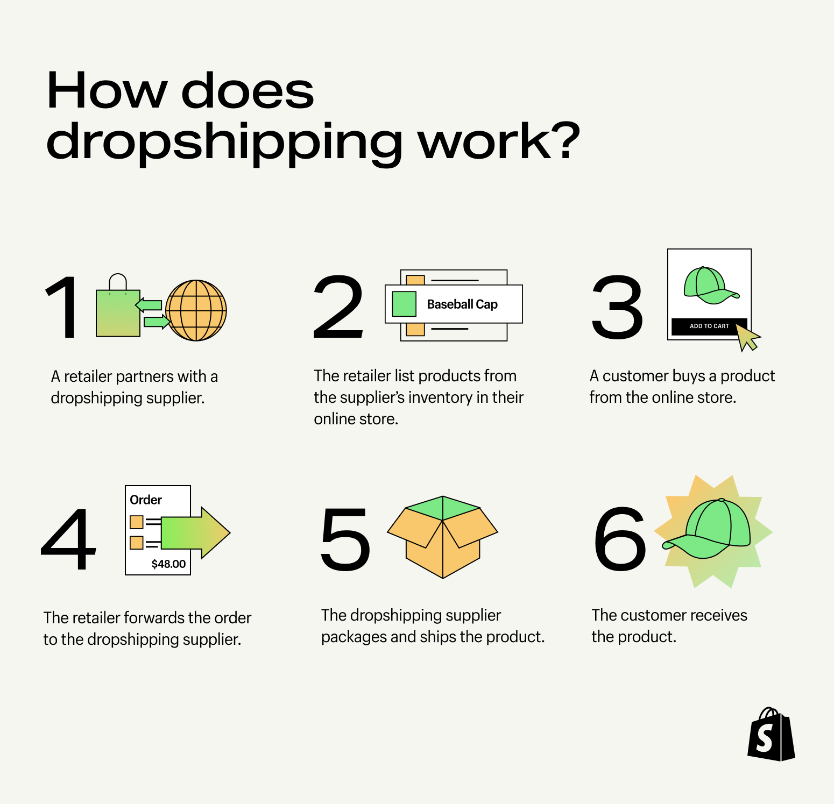
Drop shipping
to ship (goods) from a manufacturer or wholesaler directly to a customer instead of to the retailer who took the order.
to ship goods from a supplier directly to a customer

Slide 7
Qualities of a good business opportunity:
1. Profit Potential
The opportunity should have a clear path to generating profit. This means that there is a high demand for the product or service, and there are ways to scale or expand to ensure consistent revenue streams.
2. Market Demand
There must be a significant and growing demand for the product or service. A great business opportunity arises when it solves a problem or fulfills a need in the market, whether by addressing an existing gap or capitalizing on emerging trends.
3. Scalability
A good business opportunity should offer the potential for growth. This could be through expanding into new markets, increasing sales to existing customers, or offering new products or services that complement the original offering.
4. Low Entry Barriers
Ideally, a business opportunity should not require extensive capital investment or specialized skills. Low barriers to entry allow individuals to start with minimal risk and gradually build the business over time.
.

Slide 8
Qualities of a good business opportunity:
5. Competitive Advantage
The opportunity should offer a competitive advantage over others in the same market. This could be through unique features, a better customer experience, innovative technology, cost advantages, or exclusive access to a market.
6. Feasibility and Sustainability
The business opportunity should be feasible in terms of available resources, expertise, and market conditions. It should be possible to start and run with a reasonable level of effort and expense. Additionally, it should be sustainable over time, not just a short-term trend.
7. Alignment with Trends
A great opportunity often capitalizes on current trends. This could be in areas like technology, consumer preferences, lifestyle changes, sustainability, or regulatory shifts that open new markets or demand for specific products or services.
8. Clear Profit Model
The business opportunity should have a clear revenue model: how the business will make money (e.g., through sales, subscriptions, licensing, etc.). Understanding the financial structure helps mitigate risk and enhances decision-making.
.

Slide 9
Qualities of a good business opportunity:
9. Risk vs. Reward
A good opportunity presents an acceptable level of risk in relation to the potential rewards. High-risk ventures may have higher rewards, but they require careful evaluation and a solid plan. Low-risk opportunities may have slower returns but offer more stability.
10. Passion and Interest
A business opportunity is more likely to succeed if the entrepreneur is passionate about the product or service. Personal interest in the field increases commitment, resilience, and a deeper understanding of market needs.
11. Legal and Ethical Viability
The opportunity must be legally sound and comply with regulations. It's essential that there are no legal or ethical barriers to entering the market, ensuring long-term stability and brand integrity.
12. Support and Resources
A strong business opportunity often comes with access to resources, such as mentorship, a network of partners, potential investors, or supportive technology that can help the business succeed.
13. Adaptability
The business model should be flexible and adaptable to changes in the market or customer preferences. This quality helps a business thrive even as circumstances change over time.
.

Slide 10
Ways to identify an opportunity of business
1. Solve a Problem or Pain Point
Identify common problems: Look for recurring issues that people face in everyday life or in specific industries. A successful business often starts by providing a solution to a problem that hasn't been adequately addressed.
Customer feedback: Listen to customers, whether through surveys, reviews, or conversations. People often mention things they wish existed or improvements they want to see in existing products/services.
Personal pain points: Sometimes, businesses emerge when entrepreneurs solve a personal frustration or challenge.

Slide 11
Ways to identify an opportunity of business
2. Observe Market Trends
Keep an eye on emerging trends: Trends in technology, health, lifestyle, sustainability, and consumer behavior can signal growing market demand.
Global and local trends: Look for shifts in economic, cultural, or environmental factors that create new market needs.
Reports and forecasts: Study industry reports, market research, and forecasts from sources like Gartner, Statista, and government publications. These can provide insight into areas of growth.

Slide 12
Ways to identify an opportunity of business
3. Study Your Competitors
Analyze competitors: Look at businesses in your area of interest. Identify their strengths and weaknesses. Can you offer something better or different?
Gap analysis: Identify gaps in the market that competitors aren’t addressing. Perhaps they missed a niche segment or an underserved need.

Slide 13
Ways to identify an opportunity of business
4. Innovate or Improve Existing Products/Services
Product improvement: Take an existing product or service and find ways to improve it. This could involve better quality, reduced cost, enhanced features, or a more convenient delivery method.
Better customer experience: Sometimes, offering better customer service or a more user-friendly experience is enough to capture market attention.
Technology integration: Introduce new technologies to existing solutions to improve their efficiency or functionality.

Slide 14
Ways to identify an opportunity of business
5. Follow Industry or Regulatory Changes
Regulatory shifts: New laws or regulations can create opportunities, such as new markets opening up or businesses needing to comply with new standards (e.g., sustainability regulations, data privacy laws).
Technological advances: As technology advances, new opportunities for innovation and efficiency emerge. Look at how emerging tech (like AI, blockchain, or renewable energy) is changing industries.

Slide 15
Ways to identify an opportunity of business
6. Leverage Personal Expertise or Passion
Utilize your skills: If you have expertise in a specific field, explore opportunities within that industry where your knowledge gives you a competitive advantage.
Passion-driven ideas: Pursue opportunities in areas you are passionate about. Entrepreneurs who are excited about what they do often have a better understanding of customer needs and motivations.
7. Look for Franchises or Licensing Opportunities
Franchises: If you prefer a proven model, look for franchise opportunities. These often come with established branding, systems, and support.
Licensing: Licensing a product or intellectual property is another way to tap into existing successful ideas while maintaining your own brand.

Slide 16
Ways to identify an opportunity of business
8. Use the “Blue Ocean Strategy”
Create an uncontested market: Instead of competing in crowded, saturated markets, look for untapped or underserved niches. The "Blue Ocean Strategy" focuses on creating new markets where there is little competition.
Innovation and differentiation: This requires creativity to redefine an existing industry, develop a new product or service, or enter a market with unique offerings that attract customers away from established players.
9. Network and Engage with Industry Professionals
Industry events: Attend conferences, workshops, and trade shows. Networking with industry professionals can give you insights into emerging needs, and you may stumble upon a hidden opportunity.
Mentorship: Seek out mentors who can provide guidance on market trends, business opportunities, and potential risks.
Collaborations: Partnering with others who have complementary skills and resources can unlock new opportunities.

Slide 17
Ways to identify an opportunity of business
10. Analyze Demographic Changes
Changing demographics: Shifts in population, such as aging populations, urbanization, or generational preferences, can create new market needs. For example, aging populations may increase demand for healthcare services, while millennials may drive demand for sustainable and tech-driven products.
Globalization: New markets and customer segments are continually opening up as businesses expand internationally. Look for opportunities to cater to these emerging markets.
11. Leverage Social Media and Online Platforms
Social listening: Monitor social media conversations to understand customer pain points, trends, and demands. Tools like Twitter, Reddit, or Instagram can provide direct insights into what people want or need.
Influencer and community engagement: Engage with communities on platforms like YouTube, LinkedIn, or niche online forums to discover unmet needs or emerging trends.
12. Use the "5 Whys" Technique
Root cause analysis: Ask "why" multiple times to get to the root cause of an issue. This helps uncover deeper problems that need solving and could reveal an untapped business opportunity.

Slide 18
Blue Ocean Strategy
Blue Ocean Strategy is a business framework developed by W. Chan Kim and Renée Mauborgne, introduced in their book Blue Ocean Strategy (2005). It focuses on creating uncontested market spaces (blue oceans) where competition is irrelevant, rather than competing in saturated markets (red oceans). The goal is to innovate and unlock new demand by offering unique value.

Slide 19
Key Principles of Blue Ocean Strategy
Create New Market Space:
Focus on value innovation—delivering products or services that significantly improve value for customers while reducing costs.
Break away from competing in existing markets where rivals fight over limited demand.
Make Competition Irrelevant:
Redefine industry boundaries by addressing unmet needs or creating entirely new ones.
Focus on Noncustomers:
Instead of solely targeting existing customers, attract noncustomers (people who currently don’t use or have access to your product or service).
Pursue Both Differentiation and Low Cost:
Challenge the traditional trade-off between cost and differentiation by achieving both simultaneously.

Slide 20
Examples of Blue Ocean Strategy
Uber:
Created a new category in the transportation industry by combining technology with ride-sharing, making traditional taxi services less relevant.
Tesla Model S:
Merged luxury features, sustainability, and advanced technology, creating an uncontested space in the electric vehicle market.

Slide 21
Red Ocean Strategy
Red Ocean Strategy refers to a business approach focused on competing within an existing market, where industry boundaries are well-defined, and companies vie for the same pool of customers. It is characterized by intense competition, leading to a metaphorical "red ocean" filled with "blood" from rivals fighting over market share.

Slide 22
Key Characteristics of Red Ocean Strategy
Compete in Existing Markets:
Companies operate in markets with established rules and demand.
The goal is to outperform rivals and capture a larger share of the existing customer base.
Focus on Beating the Competition:
Success is often defined by outperforming direct competitors in price, quality, or service.
Exploit Existing Demand:
Red ocean strategies work within the current customer base, seeking ways to satisfy existing needs better than competitors.
Trade-Off Between Cost and Differentiation:
Companies typically choose between:
Cost leadership: Offering lower prices than competitors (e.g., Walmart).
Differentiation: Providing unique, high-value products or services (e.g., Apple).
Incremental Gains:
Companies aim for incremental improvements to their products or services rather than radical innovation.

Slide 23
Examples of Red Ocean Strategy
Airline Industry:
Airlines often compete on price, routes, and customer service in a crowded market.
Fast-Food Chains:
McDonald's and Burger King compete in the same market with similar products and promotions, focusing on price and convenience.
Automobile Industry:
Traditional car manufacturers like Toyota and Honda compete on features, price, and fuel efficiency within established segments.
Smartphone Market:
Companies like Samsung and Huawei compete for market share by offering incremental improvements in camera technology, battery life, and design.

Slide 24
Blue Ocean Vs Red Ocean
Aspect | Red Ocean Strategy | Blue Ocean Strategy
Market Focus | Compete in existing markets | Create new markets
Competition | Focus on beating competitors | Make competition irrelevant
Value Proposition | Incremental improvements to existing value | Radical innovation and unique value
Growth Potential | Limited, due to market saturation | High, by creating untapped demand
Cost-Differentiation Trade-Off | Must choose between cost or differentiation | Achieves both simultaneously

